Slide 1
So a Spaceman, a Pirate, and a Cowboy Walk Into a Bar.
By: Booker Rothenberg, Greg Hyatt, Luke Whitsell

Slide 2
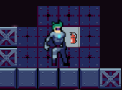
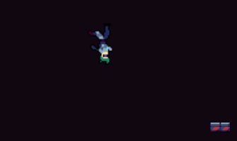
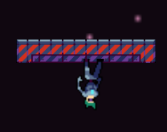
Describe how you understood the theme. How is the game an expression of the theme?
Our group used the theme reverse in a literal sense. Implementing a gravity function, where you could change whether gravity was affecting the player downwards or upwards, in a sense reversing gravity. You do this by pressing the G button and can use this ability as many times as you want.
We also used the theme for level building. The order of our levels was determined by the theme. Starting with the boundlessness of Space then shrinking down to the huge, but limited, ocean then down to a, much smaller in comparison, desert. The levels kind of go in a reverse order of magnitude and expansiveness.

Slide 3
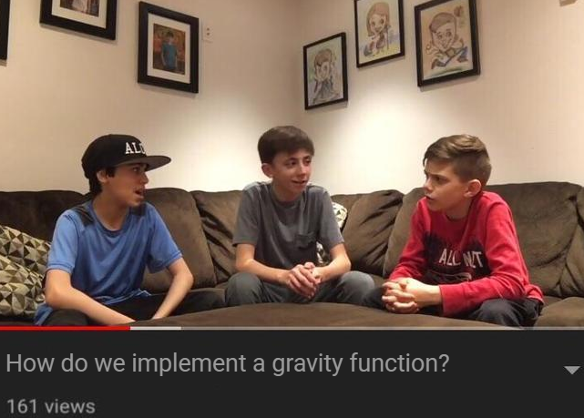
What were the roles of each of the team members?
Booker Rothenberg: Implemented movement, gravity flipping mechanic, and level exits. Designed desert level, implemented end screen.
Greg Hyatt: Implemented player animations, Designed level 1, made camera, made HUD
Luke Whitsell: Implemented title screen, designed level 2
All of us: The idea of the game, debugging, and the joke.

Slide 4
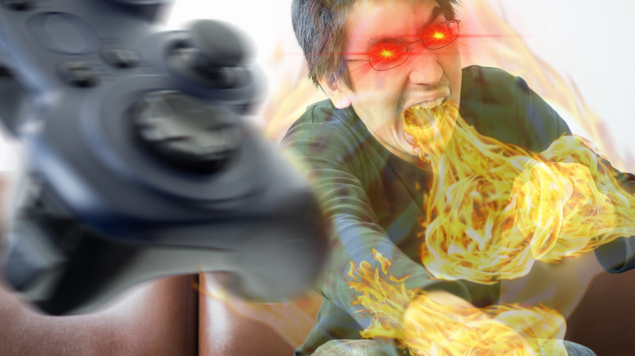
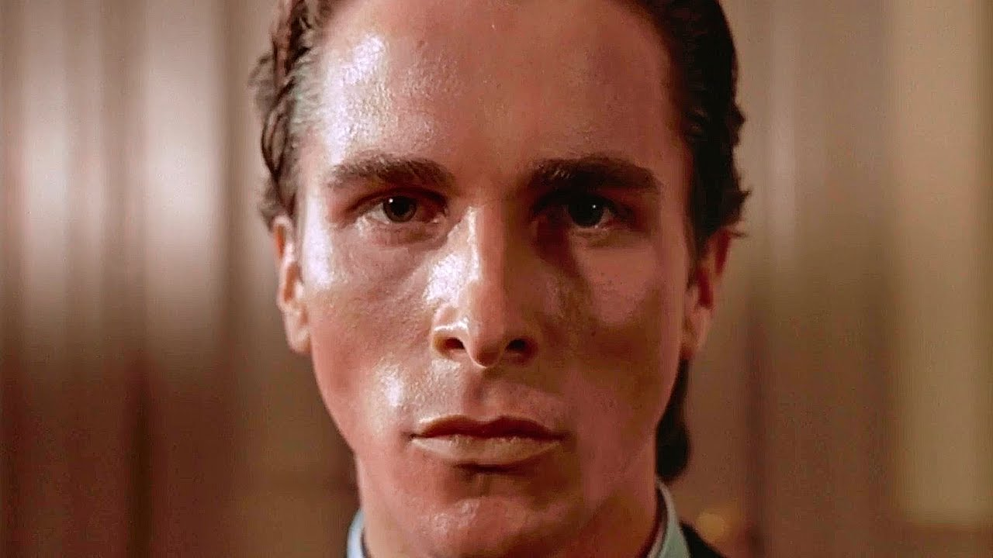
What challenges or surprises did you encounter?
Implementing the gravity function
Enemies on level one
Finding royalty free tiles that fit the theme
Flying enemy code
Our files corrupting 15 minutes before 6:15 pm
My honest to god reaction when our all our files are corrupted.

Slide 5

If you had another week to work on this project, what would you do differently? If you had another year, what features would you add?
Another week: Better enemy code, Better level design, a method of attacking the enemies, a better joke.
Another year: A two player function, more levels, more enemies, a boss battle, a key function, items you can pick up and use, likely an end game animation/screen that makes the joke that much better, and maybe our own sprites and animations if we had time.

Slide 6
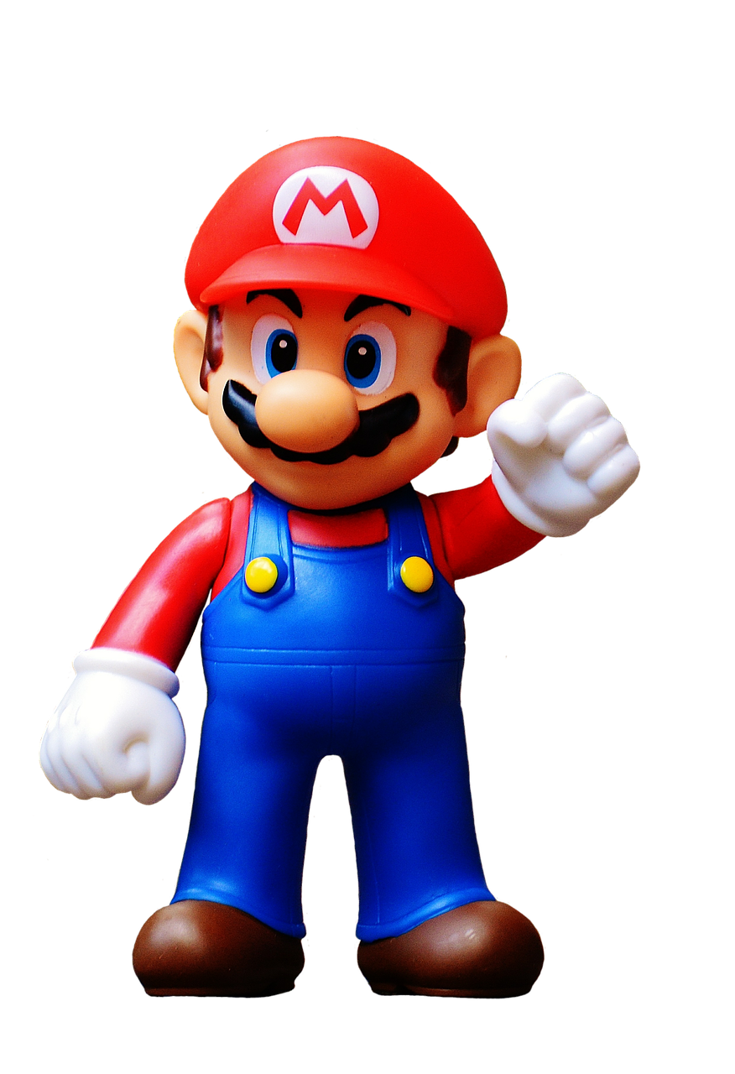
What is your vision of this game’s potential?
We think this game could be a fun platformer with a silly premise that would be focused on entertainment and wouldn’t take itself too seriously. Maybe throw in some more features that could add some silly fun, but not reduce the challenge.

Slide 7
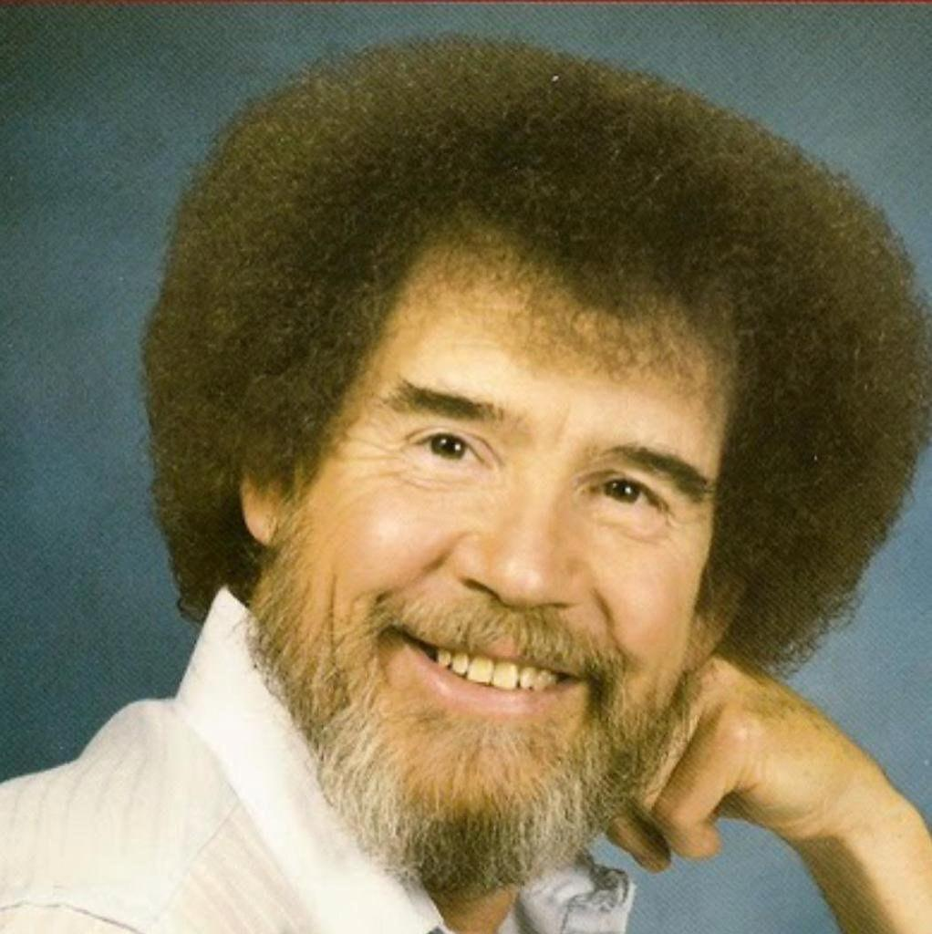
What skills would you need to develop (or hire) to realize this vision?
We would definitely need a better programmer. We could also improve level design, enemy and boss design, and the base game idea. Animating our own sprites/animations

Slide 8
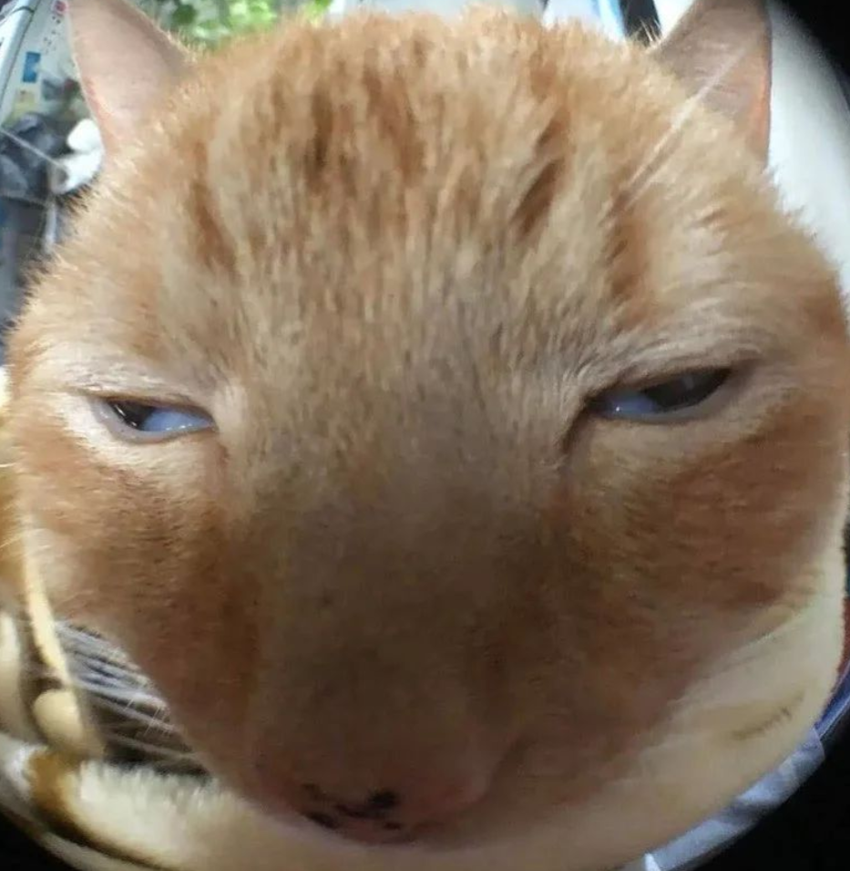
Why should we invest in your team?
Because I asked nicely.

Slide 9
Sources:
Images:
Guy looking at calendar: https://stock.adobe.com/images/middle-of-month-for-salary-man-timeline-or-schedule-concept-miniature-people-businessman-office-guy-standing-at-15th-on-calendar-looking-at-the-goal-or-target-to-launch-the-project-date/259342198
American Psycho face:
https://www.youtube.com/watch?v=JjWabkqReUU
Gamer rage stock photo:
https://www.svg.com/106846/bizarre-habits-gamers-picked-years/
Is fortnite overrated:
https://knowyourmeme.com/memes/is-fortnite-actually-overrated
The cat photo: I think I found it on Twitter - Greg
Bob Ross photo:
https://www.twitch.tv/bobross
Mario Photo:
Probably nintendo

